Slide 1
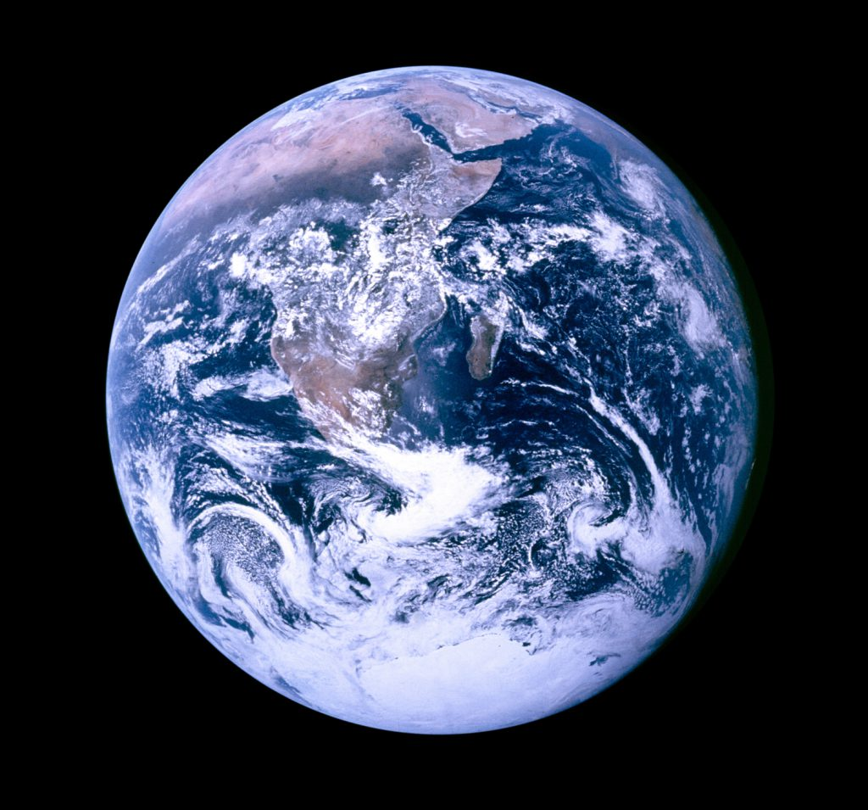
Goldilocks, Climate Change, Barriers to Action
William S. Woodfin MD

Slide 2
Earth as a Goldilocks Planet for Life
Right amount of energy from a stable star
Terrestrial planet
Liquid Water

Slide 3
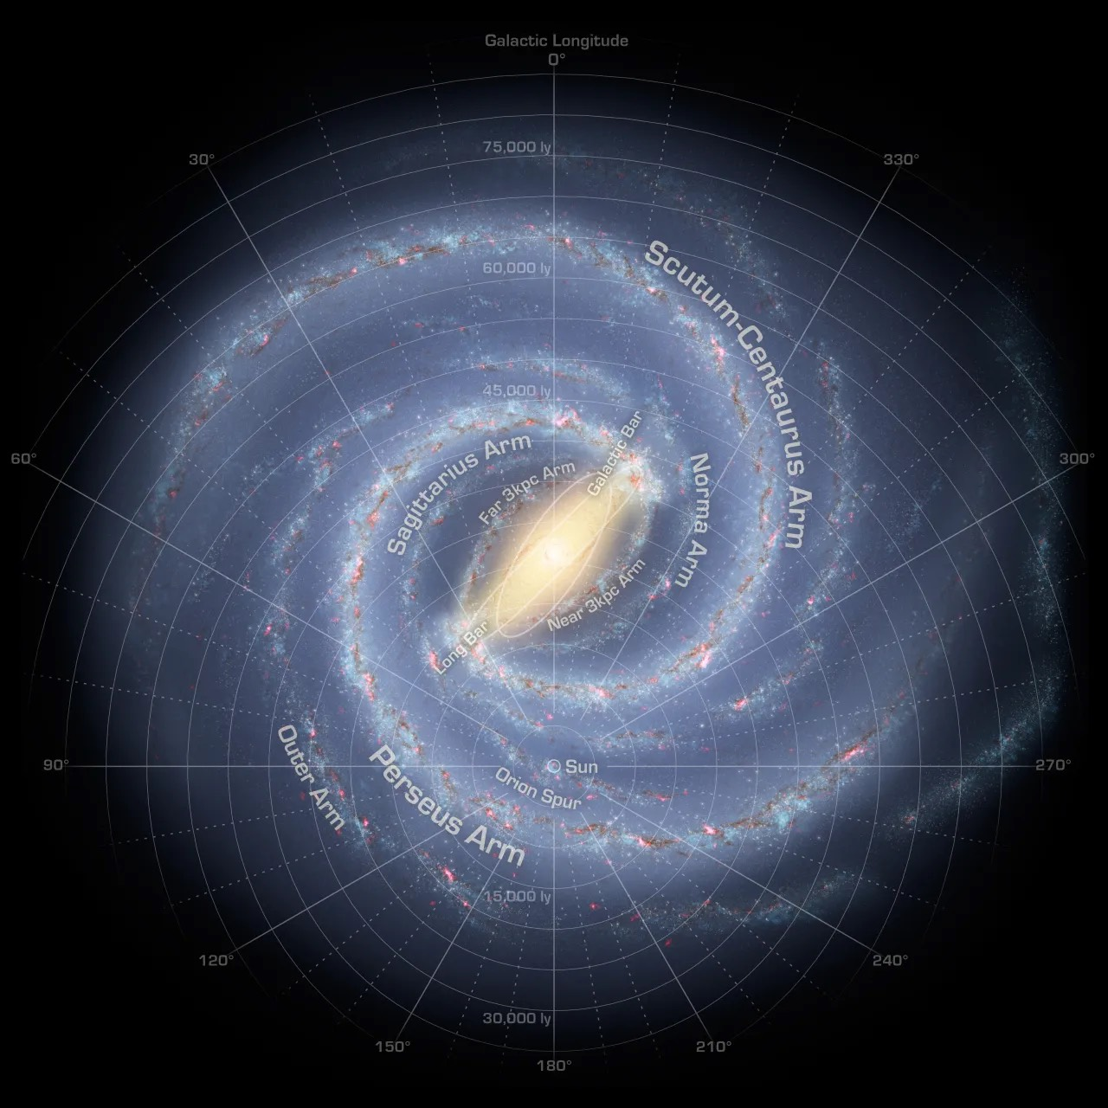
Galactic Habitable Zone

Slide 4
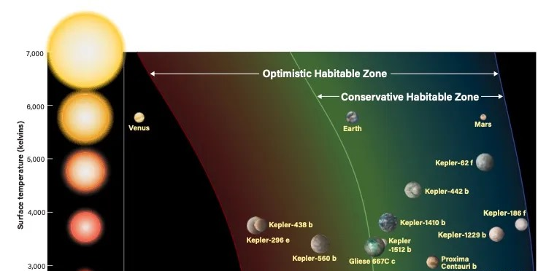
Stellar Habitable Zone

Slide 5
Our Sun
G spectral class star M (Red) dwarfs are the most common but bombard planets with solar flares. Higher mass stars hotter and shorter lived
4.6 by old, about half way through its life span. Life began ~3.8 bya

Slide 6
Our Earth
Terrestial
Stable orbit
Large Moon- stabilizes Earth’s tilt at 23 degrees + or - 1.3 ensuring seasonal cycles and that ocean tides are not too extreme
Neighboring large gaseous planet, Jupiter, to deflect asteroids and comets
Plate tectonics to allow steady evolutionary change and diversification and increasing complexity of life
Magnetic field

Slide 7
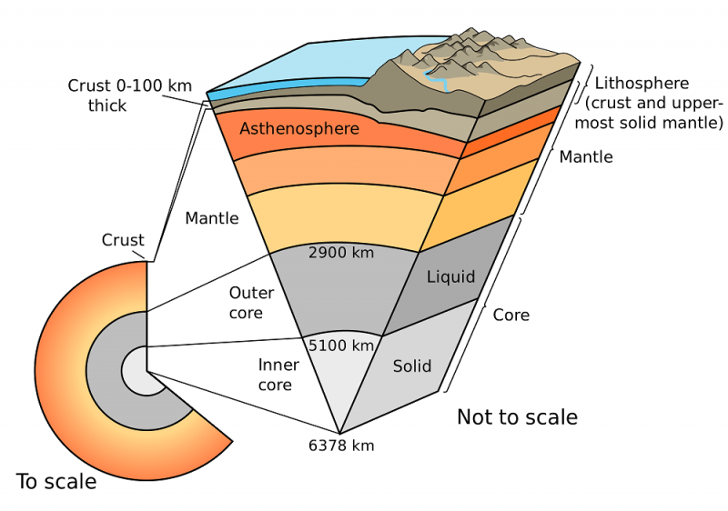

Slide 8
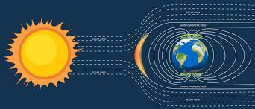

Slide 9
Oxygen
Began to about 2.7 billion yrs. ago due to photosynthesis by cyanobacteria. Prior organisms were anaerobic relying on sulfates for their energy needs
Reached the atmosphere 2.45 billion yrs. ago (The Great Oxidation Event) but required another billion years to reach concentrations that allowed the evolution of animals

Slide 10
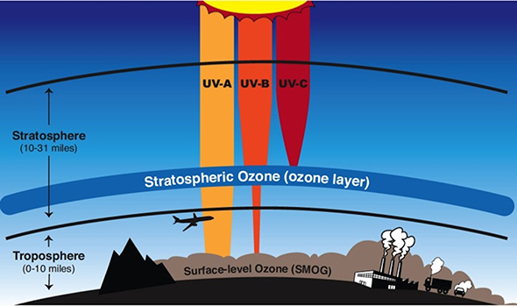
Ozone

Slide 11
Water
Perhaps the foremost requirement for life as we know it is the ability to maintain liquid water for an unimaginably long period of time
Earth with the right temperature to support all three phases of water
Venus
Mars
Enceladus
Europa

Slide 12
Temperature
Depends on the balance of energy coming in vs. energy going out- radiative balance
In addition to visible light Earth receives Ultraviolet light from the sun and radiates Infrared light back into space
Balance is maintained by what are now termed Greenhouse Gases (GHGs)

Slide 13
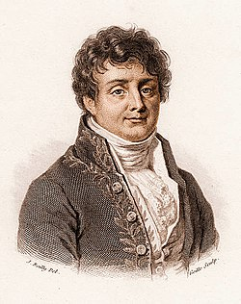
Jean-Baptiste Joseph Fourier
1768-1830

Slide 14
In the 1820s Fourier calculated that an object the size of the Earth, and at its distance from the Sun, should be considerably colder than the planet actually is if warmed by only the effects of incoming solar radiation. He examined various possible sources of the additional observed heat in articles published in 1824 and 1827. While he ultimately suggested that interstellar radiation might be responsible for a large portion of the additional warmth, Fourier's consideration of the possibility that the Earth's atmosphere might act as an insulator of some kind is widely recognized as the first proposal of what is now known as the greenhouse effect, although Fourier never called it that

Slide 15
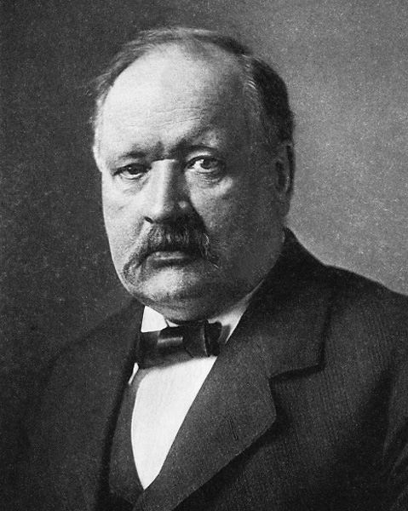
Svante Arrhenius
1859-1927

Slide 16
One of the founders of Physical Chemistry. Nobel Prize Chemistry 1903 for conductivity of electrolytes in solution
First to use basic principles of physical chemistry to calculate the extent to which atmospheric CO2 increases the Earth’s surface temperatures: “To a certain extent the temperature of the earth’s surface… is conditioned by the properties of the atmosphere surrounding it, and particularly by the permeability of the latter for the rays of heat.”
Was concerned that another ice age would ensue if not for CO2.
Led David Keeling in the 1960s to conclude and demonstrate that human carbon emissions are large enough to cause global warming

Slide 17
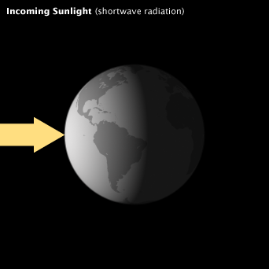
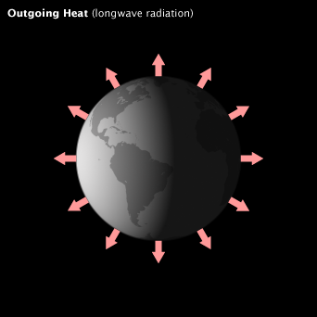

Slide 18
Visible & UV from the Sun
Infrared from the Earth

Slide 19
GHGs warm the earth by absorbing energy and slowing the rate at which it escapes into space, they act like a blanket insulating the earth. They absorb IR and radiate it back gradually like a brick.

Slide 20
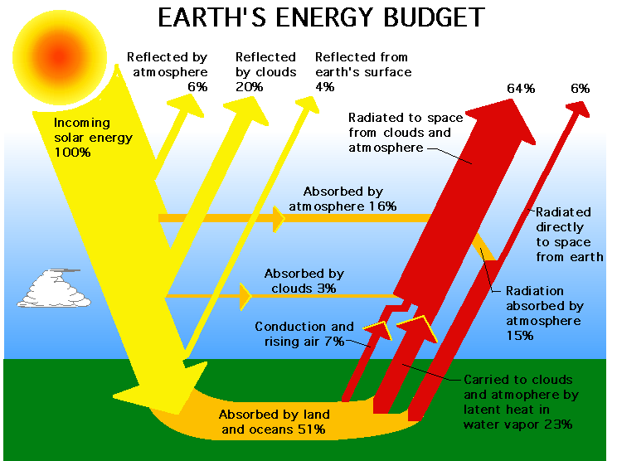

Slide 21
Chemical Composition of the Atmosphere
Gas | Symbol | Content
Nitrogen | N2 | 78.084% | 99.998%
Oxygen | O2 | 20.947%
Argon | Ar | 0.934%
Carbon dioxide | CO2 | 0.035%
Neon | Ne | 18.182 parts per million
Helium | He | 5.24 parts per million
Methane | CH4 | 1.70 parts per million
Krypton | Kr | 1.14 parts per million
Hydrogen | H2 | 0.53 parts per million
Nitrous oxide | N2O | 0.31 parts per million
Carbon monoxide | CO | 0.10 parts per million
Xenon | Xe | 0.09 parts per million
Ozone | O3 | 0.07 parts per million
Nitrogen dioxide | NO2 | 0.02 parts per million
Iodine | I2 | 0.01 parts per million
Ammonia | NH3 | trace

Slide 22
The Role of Green House Gases

Slide 23
Global Warming Potential (GWP)
Allows comparison of the global warming impacts of different gases
CO2 has a value of 1 as it is the gas used as the reference point
GWP measures how much energy the emission of 1 ton of gas will absorb over a period of time, 100 years is usually used

Slide 24
Trace gas | Atmospheric life time (Residence time) | Relative forcing
CO2 | 50-200 y | 1
CH4 | 10 y | 21
N2O | 150 y | 206
CFC-11 | 650 y | 12,400
CFC-12 | 130 y | 15,800
HCFC-22 | 15 y | 10,700
HCFC-123 | 1.6 y | 9,940
Trace gas | Atmospheric life time (Residence time) | Relative forcing
CO2 | 50-200 y | 1
CH4 | 10 y | 21
N2O | 150 y | 206
CFC-11 | 650 y | 12,400
CFC-12 | 130 y | 15,800
HCFC-22 | 15 y | 10,700
HCFC-123 | 1.6 y | 9,940
Trace gas | Atmospheric life time (Residence time) | Relative forcing
CO2 | 50-200 y | 1
CH4 | 10 y | 21
N2O | 150 y | 206
CFC-11 | 650 y | 12,400
CFC-12 | 130 y | 15,800
HCFC-22 | 15 y | 10,700
HCFC-123 | 1.6 y | 9,940

Slide 25
Mechanism
How do GHG which are such a small percentage of the atmosphere (CO² composes only 0.035% and total for all but for water vapor is <1%) make so much difference?
We return to Radiative Balance and UV and IR light

Slide 26
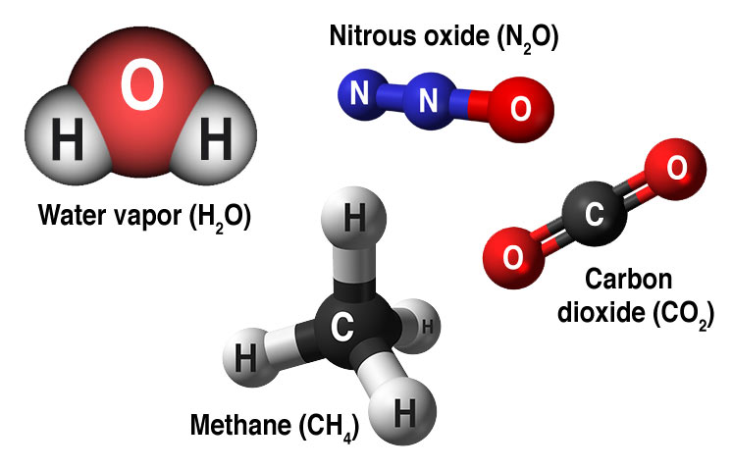

Slide 27
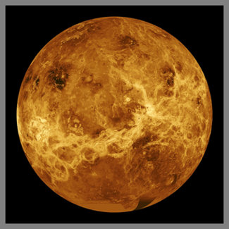
Venus
CO2 96.5% Temp. 900ºF

Slide 28
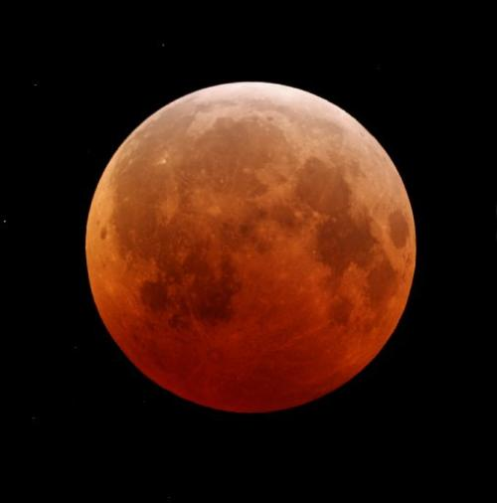
Moon
No atmosphere Temp. -33ºF

Slide 29
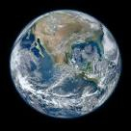
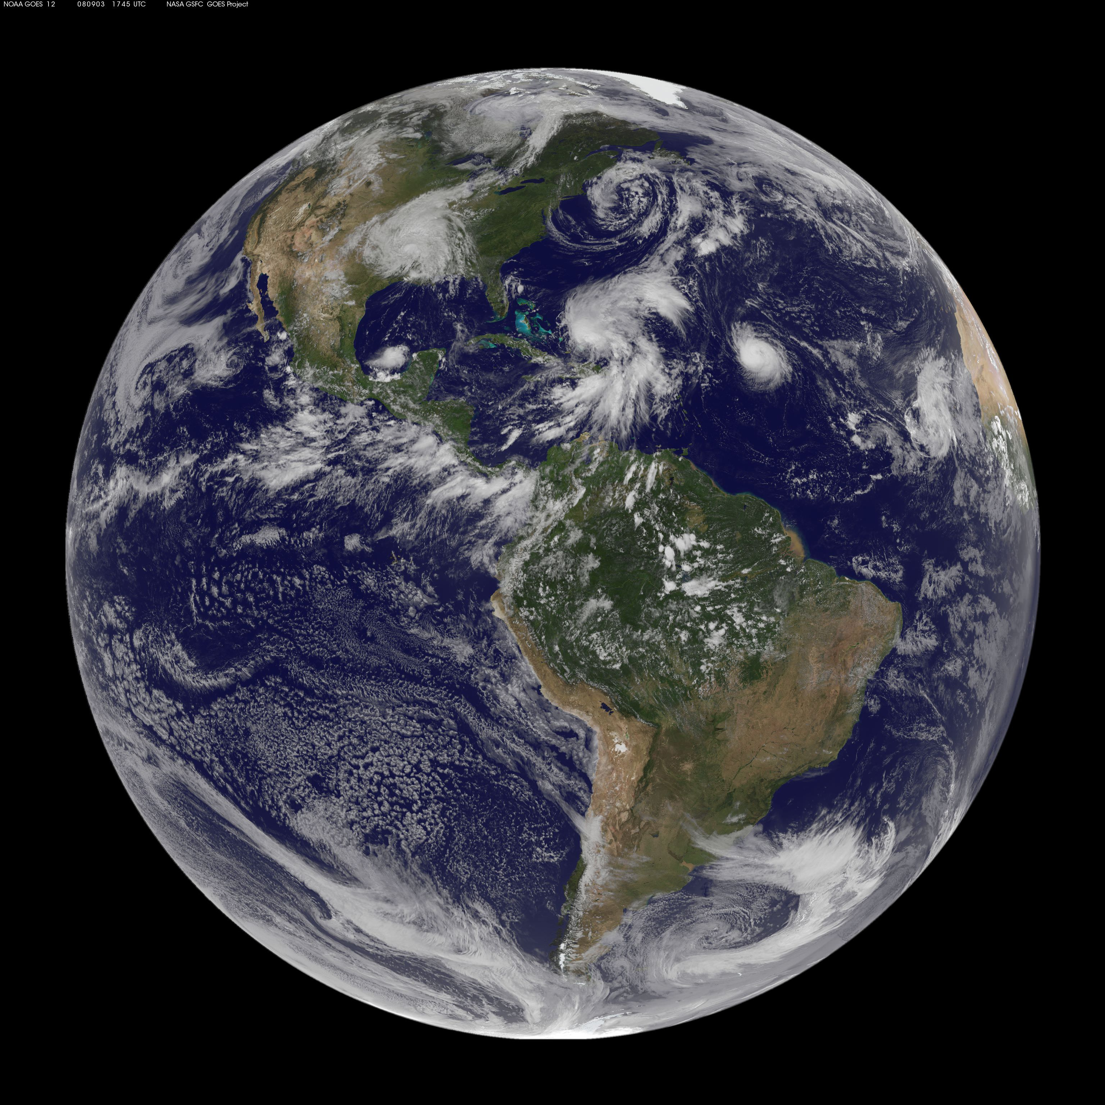
Earth
CO2 0.0413% Temp. 57.2ºF

Slide 30
History
Natural GHG*: Water Vapor (1-4% of the atmosphere)
GHGs from fossil fuels: Carbon Dioxide, Methane, Nitrous Oxide, CFCs
Effect on Radiative Balance
CO², CH⁴, and N²0 also occur naturally in the atmosphere

Slide 31
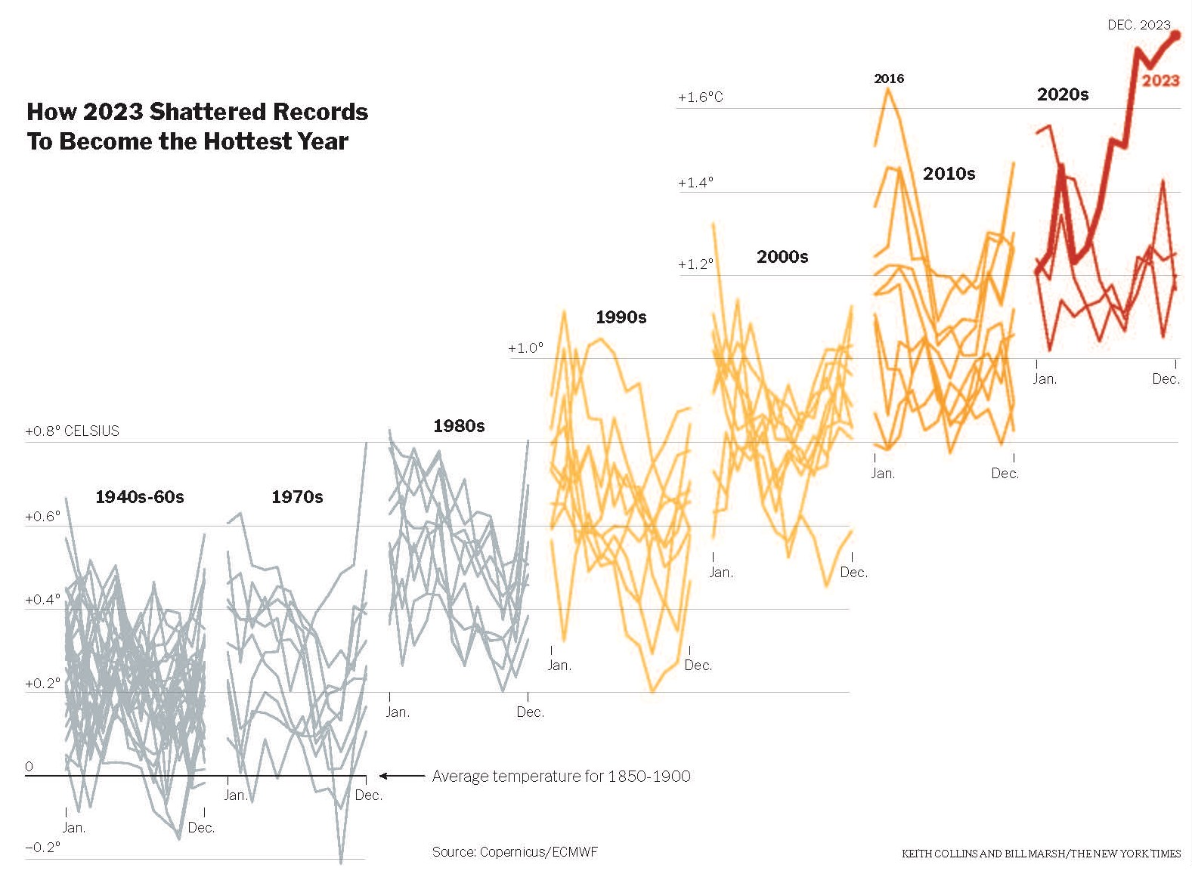
It’s Getting Hotter

Slide 32
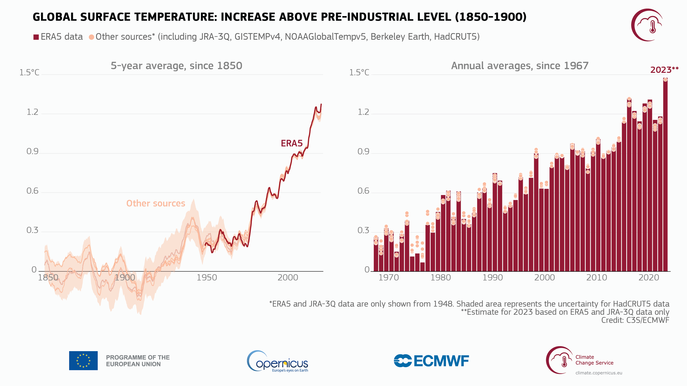

Slide 33
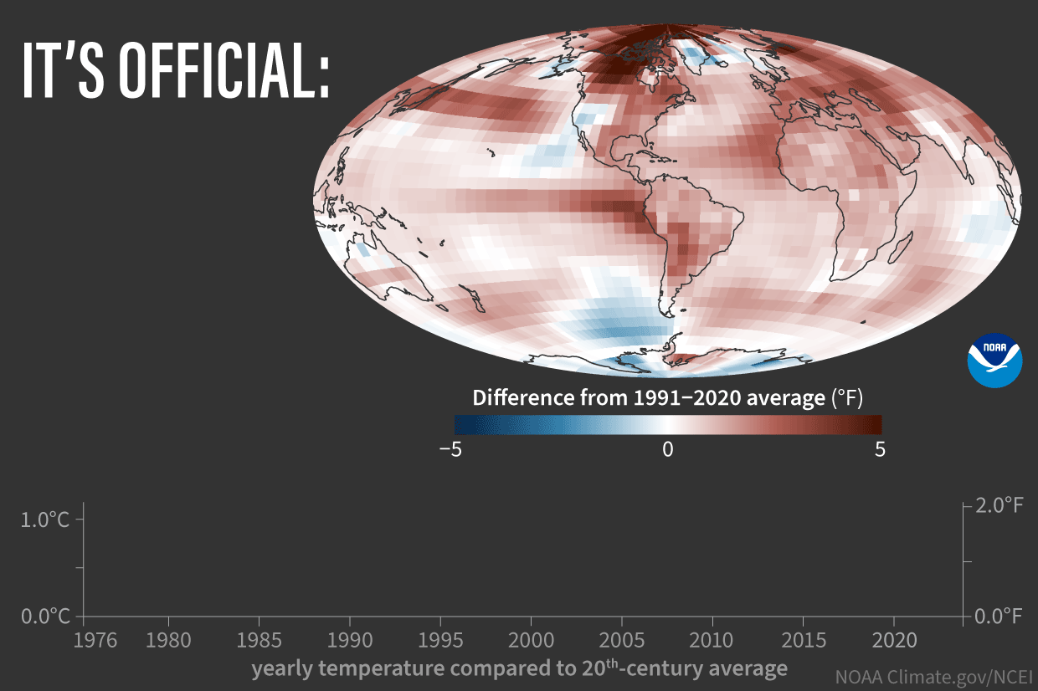

Slide 34
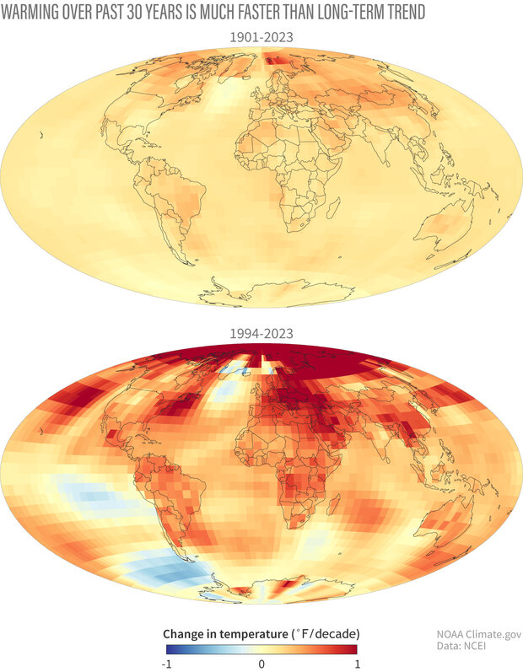

Slide 35
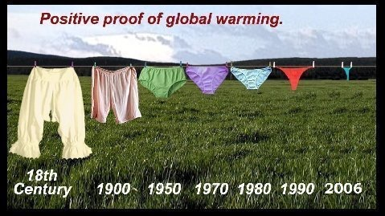

Slide 36
WHY?
Is it Nature or is it us?

Slide 37
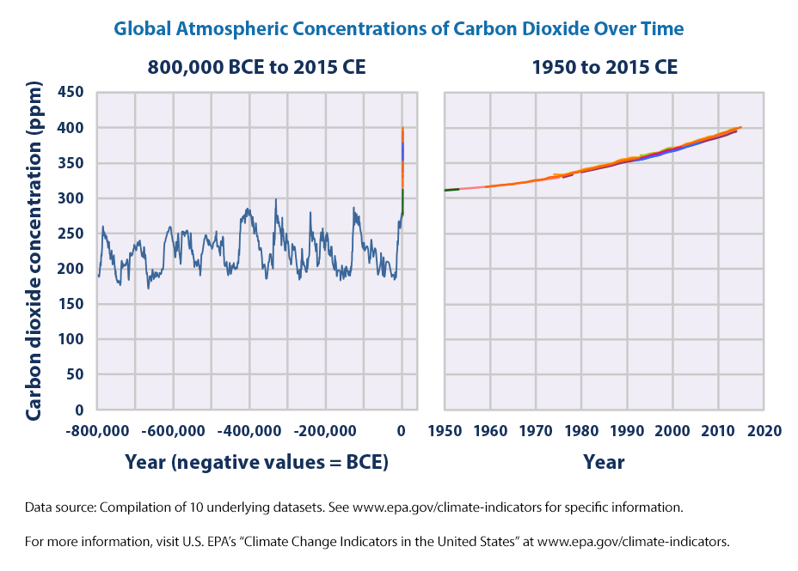

Slide 38
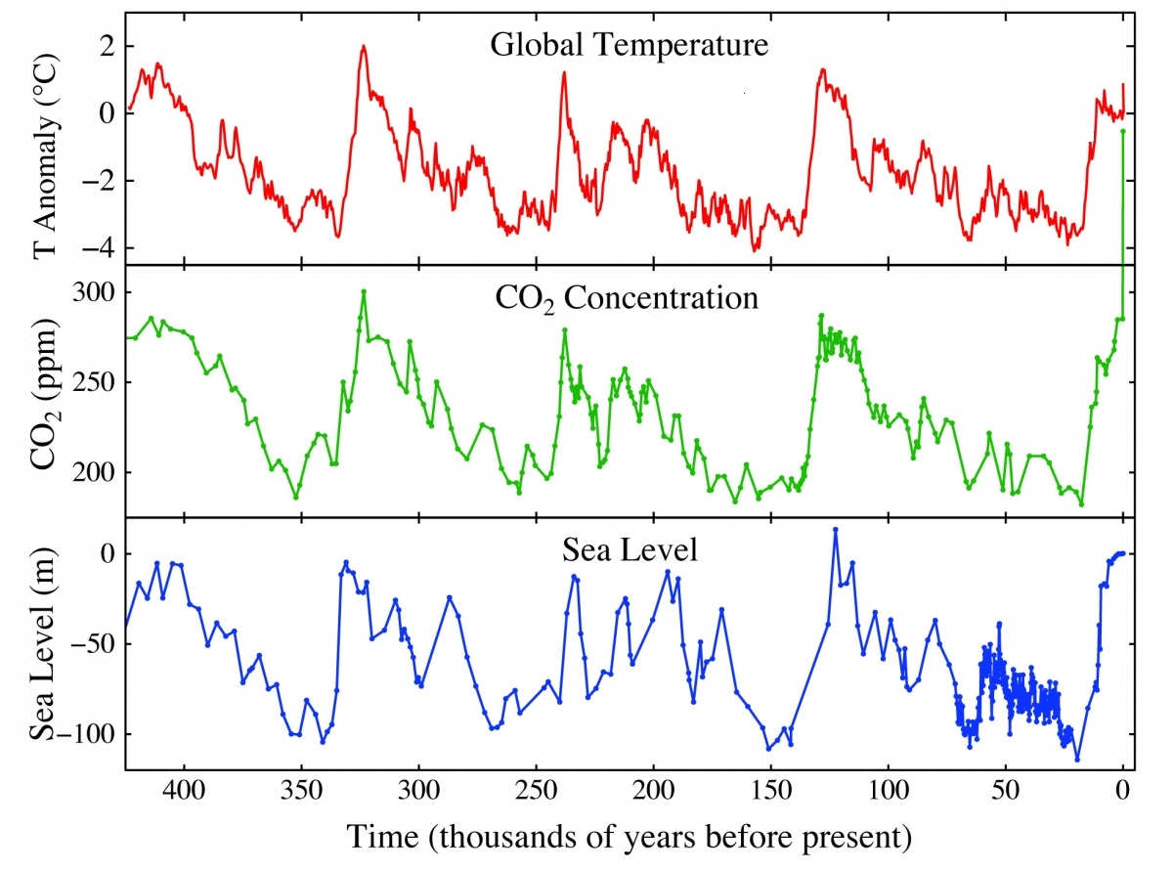

Slide 39
Milutin Milankovic
1879-1958
Mathematician, Astronomer,Climatologist, Geophysicist
Studied the earth’s insolation and long term climate changes resulting from the earth’s positioning relation to the sun to explain Ice Ages and to calculate future climate
Worked With Alfred Wegener on Plate Tectonics
Popularized science

Slide 40
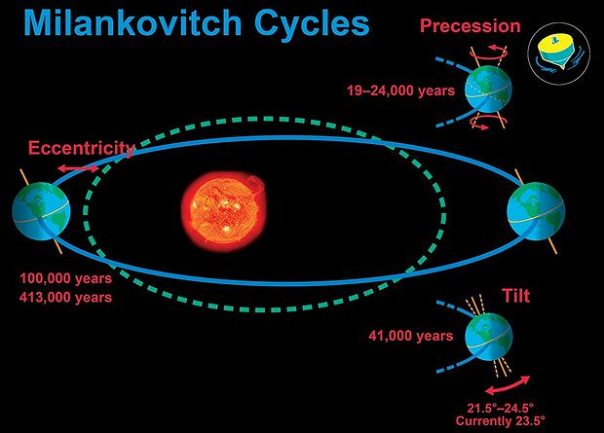

Slide 41
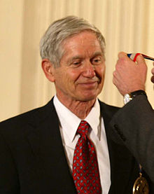
Charles Keeling
1928-2005

Slide 43
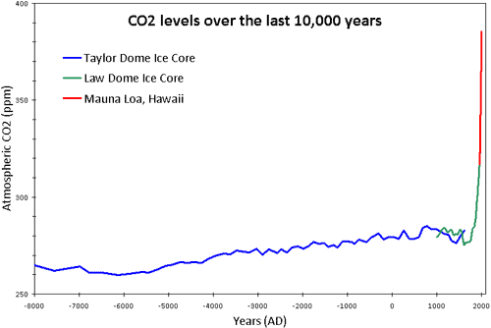

Slide 44
Carbon Isotopes
Fossil fuels originated as plants
Spectrometry used to measure atmospheric ratios of ¹⁴C to ¹³C and ¹³C to ¹²C
Both ratios lower in atmospheric carbon from fossil fuels
Former due to ¹⁴C half life of 5,700 years so that it is absent from fuels created hundreds of millions of years ago
Later due to plant preference for ¹²C

Slide 45
Temperature rise is not as smooth as the rise in GHGs because other factors- El Niño, volcanos, aerosols etc.- can superimpose themselves but everything is “coming up very, very hot.”
March was the hottest March ever recorded
Over the last 12 months global temperatures have been 1.58 C (2.84F) above pre-industrial levels
Warming is accelerating much faster than climate modeling has been anticipating and implying that a warming planet is already fundamentally altering the way the climate system operates

Slide 46
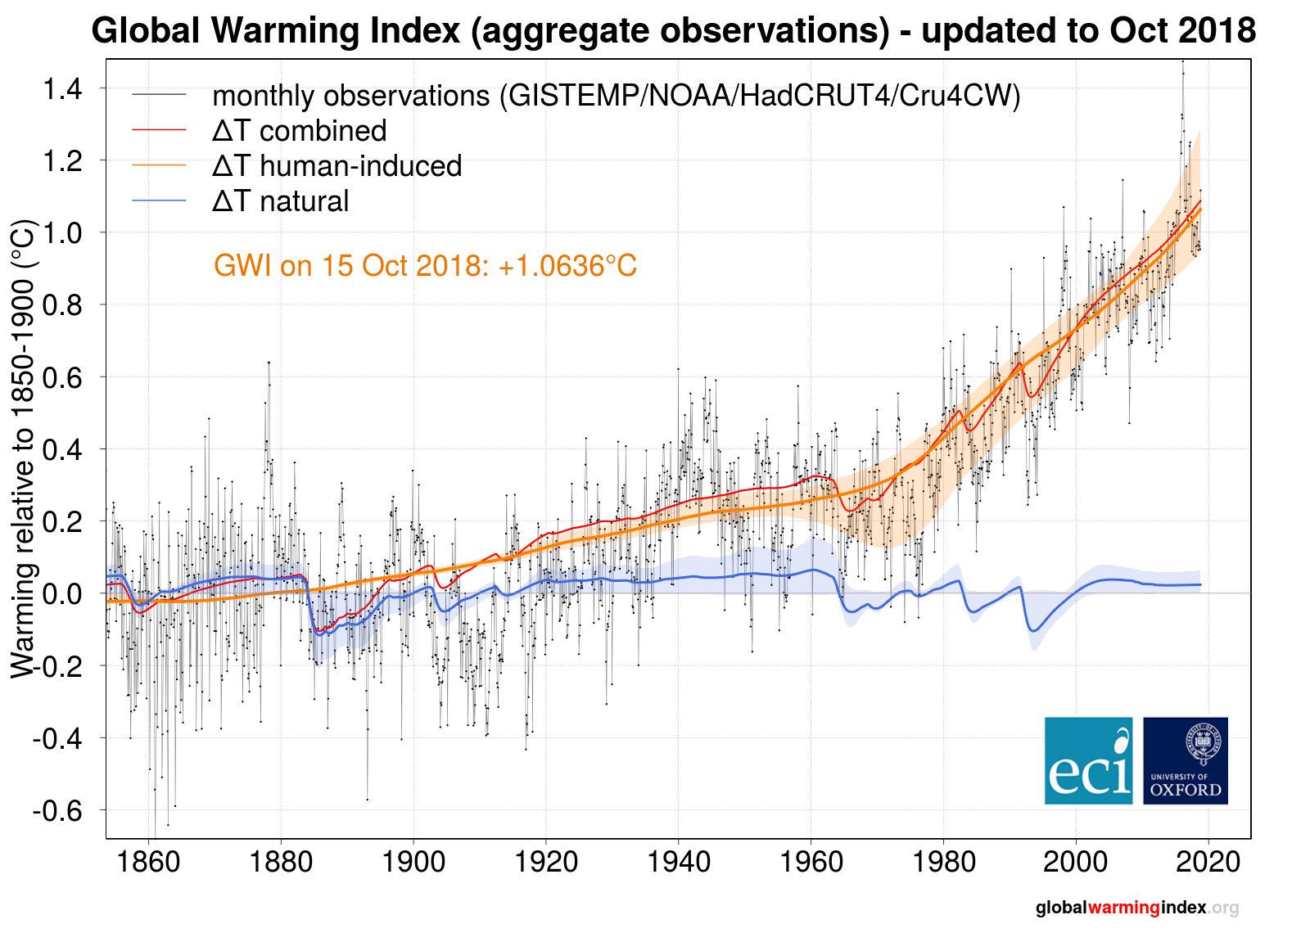
Is Warming Due to Natural Variability or Anthropogenic?

Slide 47
Consequences
Altered, less predictable, “weird” weather
More intense floods, drought, storms
“Wobbling” of the jet stream as warming at high latitudes exceeds that at lower latitudes
Alteration of ocean currents, eg. the AMOC (Atlantic Meridional Overturning Current) producing major regional climates changes
More heat related illness, spread of disease carrying vectors and associated infectious diseases, eg. Dengue, Malaria, STARI, Lyme, Zika, West Nile
Increased human displacement, migration, and political disorder
Sea level rise associated with melting ice and thermal ocean expansion

Slide 48
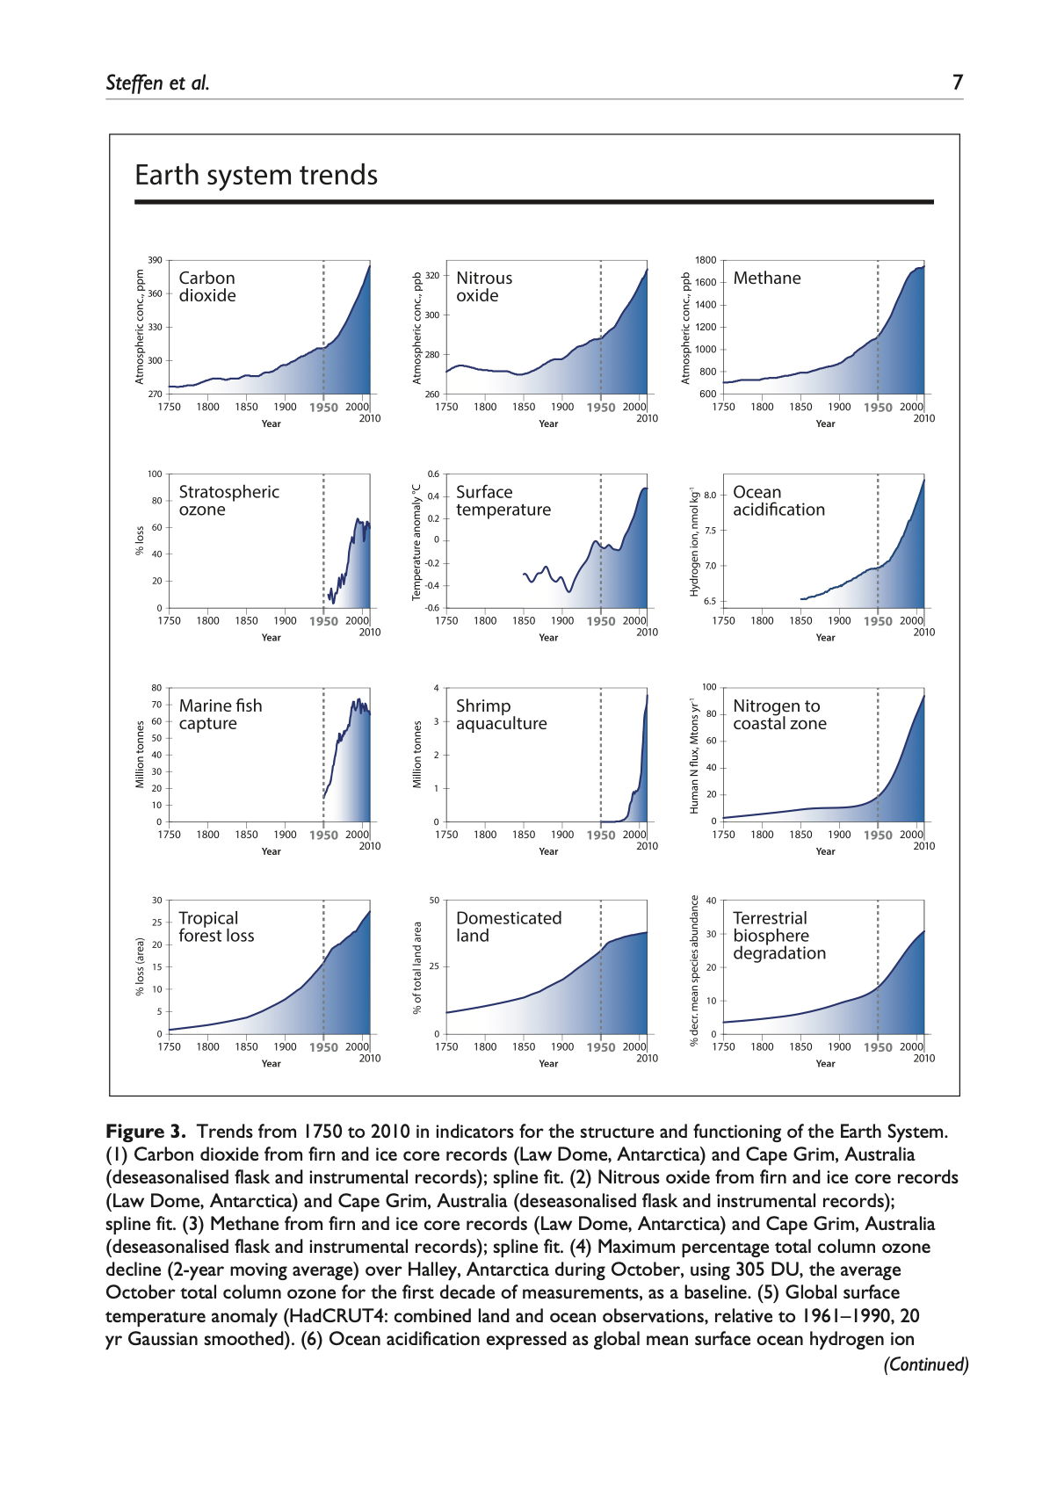

Slide 49
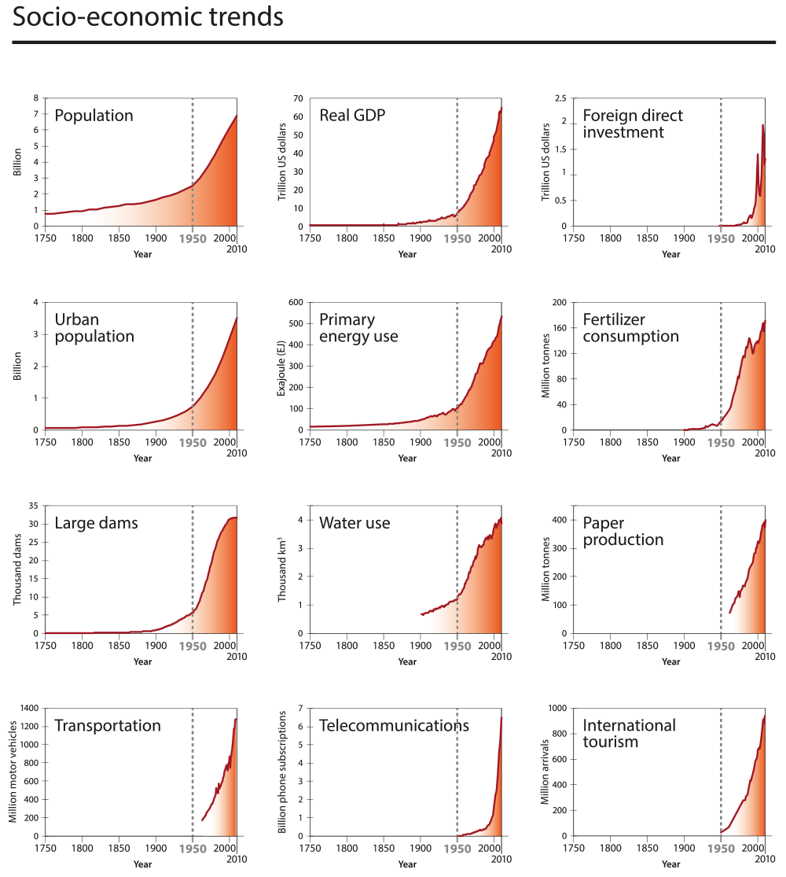

Slide 50
Uncertainty is the nature of science. Our brains are uncomfortable with uncertainty
Psychological distance, spatial and temporal: It isn’t happening now and it doesn’t affect me. If conditions are perceived to be worse elsewhere we are less inclined to react locally and in the present. Other factors include denial and over optimism.
The slow pace of evolution or “Ancient Brain”: Technology has advanced rapidly over the last 70 years but our brains haven’t caught up. We continue to think in the here and now, it’s difficult to think more than a decade ahead. Our brains reached their current physical ability before the development of agriculture. Our ancestors were mainly concerned with their immediate band and environment, immediate dangers, exploitable resources, and the immediate time.
Economic momentum: For the past 250 years our economy and wealth has been based on fossil fuels. Our parents relied on them for all of their lives. We’re “imprinted” on fossil fuels, we’ve known of no other sources of energy until recently. Transition to green energy is going to require a profound alteration in our manufacturing, trade, and transportation. We have tremendous “sunk costs,” financial investments, in the current system. We’re not keen to trade the vehicle we just paid off for a low carbon one

Slide 51
Structural: Low income limits the choices many people can make eg. affording solar panels or an EV. Rural residents have little resort to public transportation. Electric engines are not currently adaptable for long range aircraft
Genuine ignorance: Not knowing that a problem exists and not knowing what to do about it once it’s apparent
Perceived inequity: Why should I change if they won’t change? Why should we sacrifice here if China and India are building more coal plants?
The problem of “The Commons” or placing individual advantage above the welfare of the community

Slide 52
Lack of agency: It’s overwhelming and I as an individual can do nothing about it
Misinformation and Disinformation: Corporations and individuals denying global warming exists or stating that it’s not a problem - Greenwashing. The same or similar entities going on the offensive - Greenlashing
Political Tribalism

Slide 53
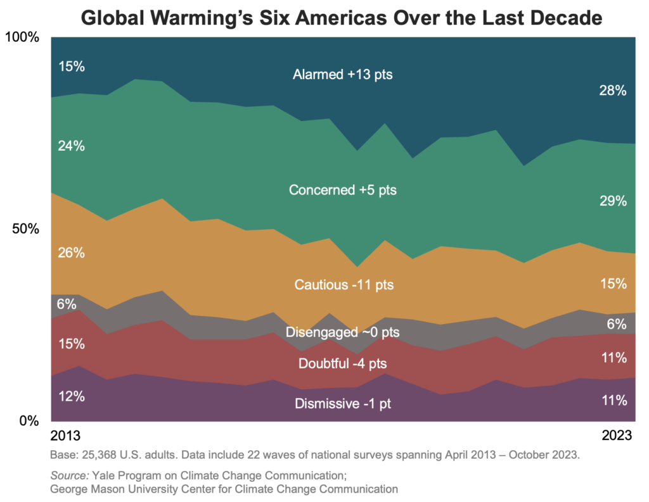

Slide 54
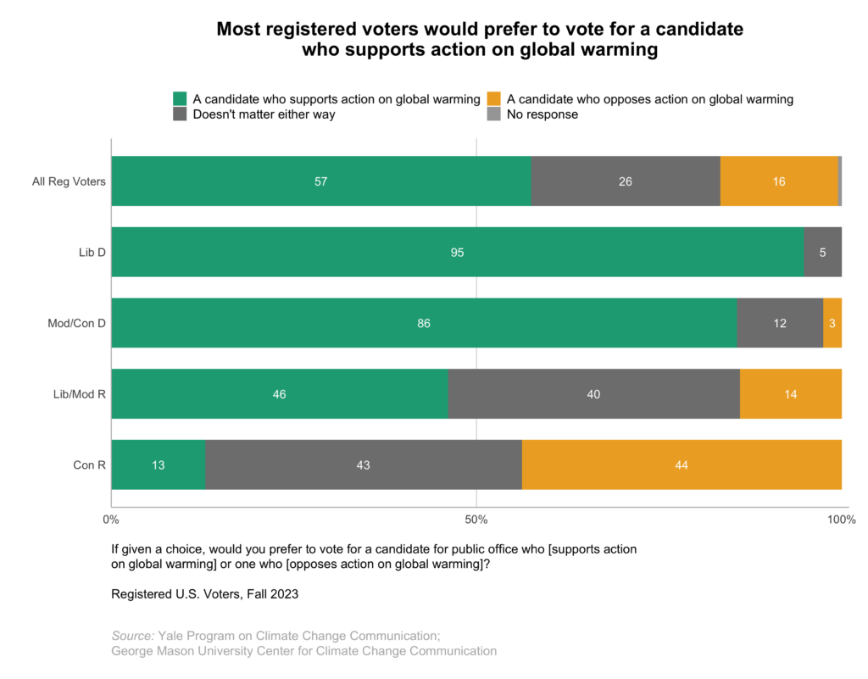

Slide 55
Over the last 10 years the public has come increasingly to understand that global warming will affect the weather
Over the last 5 years worry about extreme heat has especially increased

