Slide 1
The Life, Times, and Philosophy of Friedrich Nietzsche Robin Olson, MLA, CPCU, ARM Dallas Philosopher’s Forum International Risk Management Institute, Inc.

Slide 2
Nietzsche Lecture Goals
Provide a brief biography of one of the more profound philosophers of the last few centuries
Offer a short discussion of the times in which Nietzsche lived
Address the key aspects of his philosophy, including his critique of mass culture, truth and perspectivism, master-slave morality, will to power, overman, and Nazi connection
Conclude with his literary style, concept of aesthetics, and philosophical impact

Slide 3
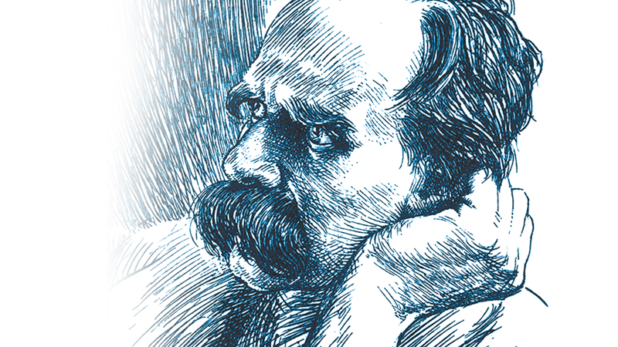
The Life of Nietzsche

Slide 4
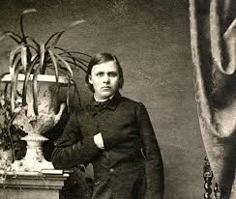
The Life of Nietzsche
1844-1900
Born Prussian Province of
Saxony—his father was a
Lutheran Minister
German philosopher, poet, cultural critic, philologist, and Latin and Greek scholar—spoke five languages, including French and Hebrew

Slide 5
The Life of Nietzsche
Later became enamored with philology but also thoroughly studied Schopenhauer, Kant and the early Greeks
Voluntary service with Prussian Army
Offered a full professorship of Classical Philology at the University of Basel in Switzerland (youngest ever—age 24) prior to receiving his Ph.D.

Slide 6
The Life of Nietzsche
Resigned in 1879 at age 35 due to poor health
Completed much of his core work during the next decade
Suffered a collapse and complete loss of mental facilities in 1889 at age 45
Lived with mother and later his sister who cared for him
Death in 1900 at age 55

Slide 7
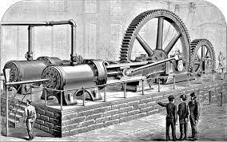
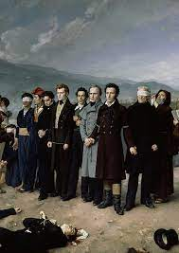
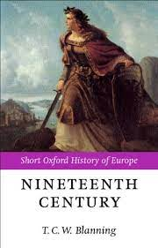
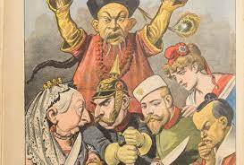
The Times of Nietzsche

Slide 8
The Times of Nietzsche
French Revolution in 1789—its effects reverberated in Europe for many decades
19th Century was a revolutionary period for European history—a time of great transformation in all sphere of life—human and civil rights, science, democracy and nationalism, industrialization and free market systems
Changes more pronounced in Western Europe, as compared to Eastern and Southern Europe

Slide 9
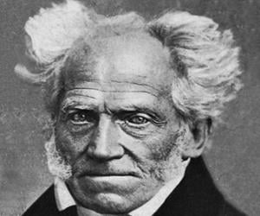
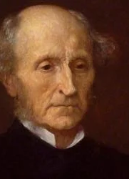
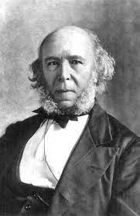
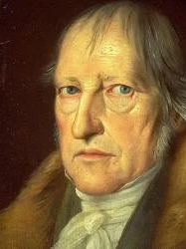
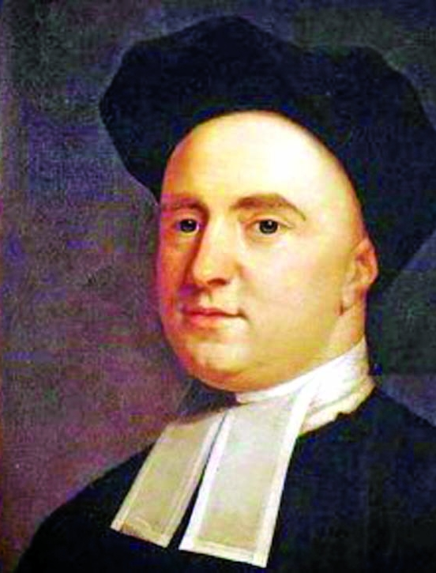
Philosophors in 18th & 19th Century

Slide 10
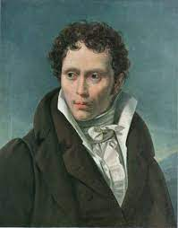
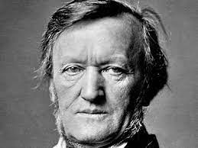
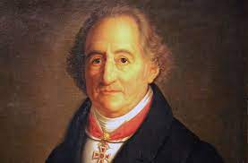
Influencers for Nietzsche
Schopenhauer
Wagner
Goethe

Slide 11
Philosophy of Nietzsche

Slide 12
Philosophy of Nietzsche—Areas to Address
Critique of Mass Culture
Truth and Perspectivism
Master/Slave Morality
Will to Power
Superman
Value Creation and Pluralism
Determinism
Nietzsche and Nazism
Literary Style, Sense of Aesthetics and Legacy

Slide 13
Critique of Mass Culture
Attacks on:
Christian morality—compassion for poor and the weak. He despised the support of the weak person from the outside. “Mystical explanations are thought to be profound; in fact, they are not even superficial.”
Secular and Kantian Morality (dislikes rules and regulations, systems, and generalizations). General equals common. Great men stand above this. There are no more standards of good. Rejects utilitarianism.

Slide 14
Critique of Mass Culture
Attacks on:
Common Herd Morality (anti democratic). Nietzsche is the philosopher of the great and noble men. The press and mass culture leads to mediocrity.
Ancient Greece (Socrates forward-Pre-Socratics was Golden Age of Greece). Socrates--too much emphasis on rationalism rather than instinct and concept of elan vital. Nietzsche preferred Heraclitus (e.g., unity of opposites)

Slide 15
Truth and Perspectivism
Perspective (“optics” of knowledge)
Rejected the Platonic concept of true reality; there is no objective reality per Nietzsche.
Every perspective is a unique one (language of vision)
One perspective only—distorting, short-sighted way to view the world.

Slide 16
Truth and Perspectivism
Nietzsche Quote

Slide 17
Truth and Perspectivism
How to combat this?
Consider the opposite of values
A person must realize his perspective is just that—only one perspective; humility; this is an improvement
Avoid being trapped by one set of values (blind spots)
Recognize error blindness
Consider many perspectives—exploit and explore the differences in many perspectives—get closer to a truth

Slide 18
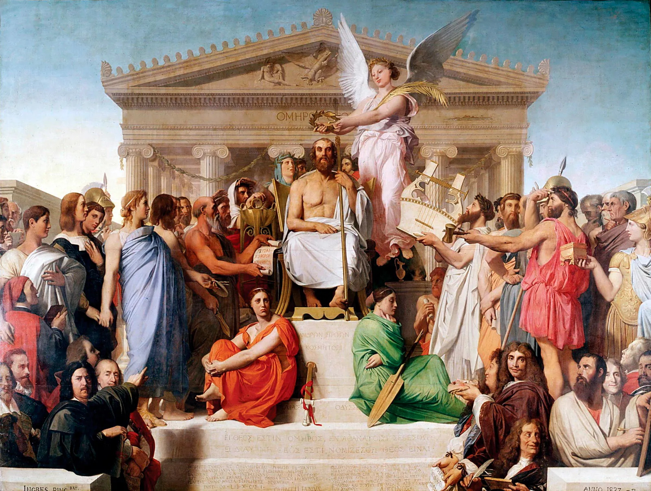
Master/Slave Concept
Master morality—original system of morality, perhaps best associated with Homeric Greece. To be good was to be happy and to have related things—wealth, strength, command, power. It stands beyond good and evil. Transcends mediocrity.

Slide 19
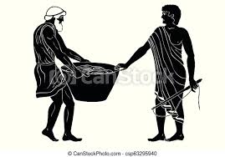
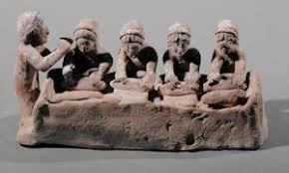
Master/Slave Concept
Slave morality—pessimistic and fearful; following the herd. Raising up the weak. Values of kindness, humility, fear, compassion, sympathy. Herd attempts to impose its values universally.

Slide 20
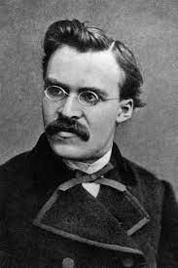
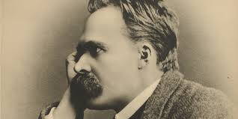
Will to Power

Slide 21
Will to Power
Main driving force in humans—achievement, ambition and the striving to reach the highest possible position in life; instinct
Various cells fight for life and struggle for finite resources; same as man
Will to power different than Schopenhauer’s will—he reverses it
Will to power stronger than the will to survive
All reality is best understood in terms of competing wills

Slide 22
Will to Power
Happiness is not an aim per se (anti-utilitarian position)
Instead, it is a consequence of a successful pursuit of one’s aims, of overcoming hurdles
Rejects Plato’s concept that people want to be united with the good; rather, the will is beyond good and evil
Even truth must be subjugated to the strength and passion of the will to power
Greatest use is to apply will to power to oneself

Slide 23
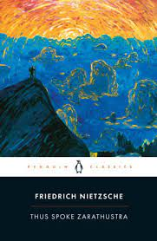
Superman (or Overman)

Slide 24
Superman
Superior man could arise in any culture
Man with superior potential completely masters himself and strikes off conventional Christian “herd morality” to creates his own values, which are completely rooted on life on this earth. A “Caesar with Christ’s soul.” Or a Napoleon or a Goethe.

Slide 25
Superman
He is a law unto himself
Uses his will to power to influence generations to come in a creative manner
Creates new values
The solution to the problem of the death of God and nihilism
Superman is to man as man is to the great apes
Rises above the notion of good and evil

Slide 26
Value Creation and Pluralism
In the aftermath of the scientific revolution, we must create our own values
Value creation connected to myth, poetry, music and artistic endeavors, not from super rationalism
Nietzsche praises many different values and urges readers to create their values
Avoid systems or systematic thought

Slide 27
Value Creation and Pluralism
Affirms a plurality of beliefs and values while rejecting Christianity
His axiology demands analysis of counterforces and dialectics
Instincts and the unconscious can form values
A person being responsive to a multitude of values, virtues, perspectives is a positive good
Value commitments interact in complex patterns to inform and sometimes limit one another

Slide 28
Determinism v Free Will
Nietzsche falls in the biological determinist camp
Free will--cannot be separated from its religious underpinnings
Any given person’s thoughts or actions are an expression of their underlying traits.
Sheep or wolf? A matter of biology and of instincts
Illusion of free will/freedom
But there is tension in his position (e.g., Dionysian v Apollonian)

Slide 29
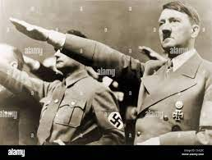
Nietzsche and Nazism
To what extent were the Nazi’s accurate in portraying Nietzsche as their Patron Saint or as the precursor to their movement?
Probably a split decision

Slide 30
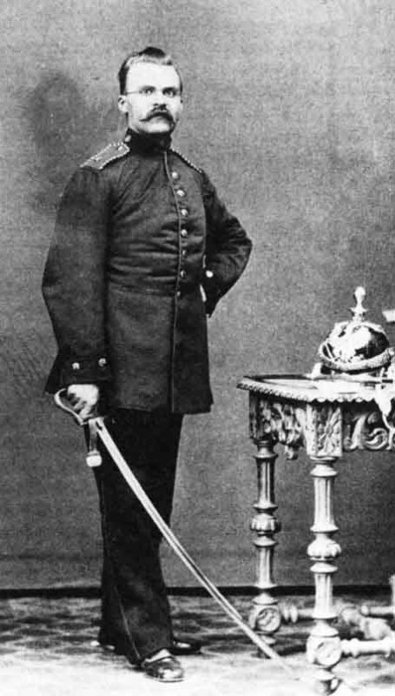
Nietzsche and Nazism

Slide 31
Nietzsche and Nazism--Similarities
Anti-individualism and collectivism—individuals are not ends in themselves—they are part of the Volk, the German people
Conflict is a fundamental human reality. Life is an ongoing struggles between strong and weak.

Slide 32
Nietzsche and Nazism--Similarities
Instinct, passion, and anti-reason should rule the day; Elan Vital; great conflicts will not be solved rationally
Authoritarianism, not democracy nor liberalism—Nietzsche favors some type of aristocracy or even a philosopher King; rule by the superior overman; Democracy— “mania for counting noses”

Slide 33
Nietzsche and Nazism—Differences
On the Blonde Beast and Racism—says many races can become dominant; Germans not special
Not complimentary on the Germans—a nation of liberalism and religious revivalism
Opponent of antisemitism—sees it as a moral sickness; he is almost a philo-semitic

Slide 34
Nietzsche and Nazism—Differences
Admired the tenacity of the Jewish people—the “Jews are . . . The strongest, toughest and purest race now living in Europe.” BGE
Considered Judaism and Christianity as allies, both stemming from same source

Slide 35
Nietzsche—Literary Style
Strong use of oxymorons-tied to his concept of self-contradictions
Fusion of poetry, prose, aphorisms—possesses the lyricism of a poet—speaks to emotions
Thought experiments in his prose—eternal recurrence
Spans philosophical polemics, cultural criticism, and fiction; use characters such as snakes, lions, eagles, and tightrope artists
Difficult to interpret his views

Slide 36
Nietzsche—Aesthetics
Art, poetry, and myth can liberate a person
Need both the Apollonian and Dionysian forces—tension between two opposites
Poetry is The Gay Science
Pre-Socratic Greece was the golden age
Idealized Homer and attacked Socrates and Plato—Socratic argy bargy

Slide 37
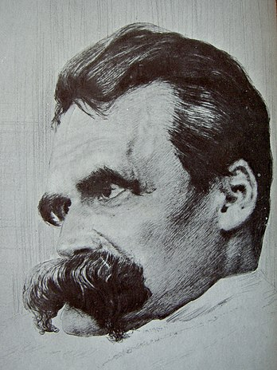
Nietzsche—Legacy

Slide 38
Nietzsche—Legacy
Sold few books during his active writing career
Appreciation for his views grew in early 20th Century
Huge impact on Jack London, Bertrand Russell, Jean-Paul Sartre, Albert Camus, and Ayn Rand
Reputation declined due to association with Nazi’s
Today, his work often serves as an inspiration to people to overcome obstacles and attain great achievements

Slide 39
Nietzsche—Q & A

